Slide 1
Study Environment, Boolean Logic, & HDL
Study Environment Discussion, Boolean Logic and Functions, Hardware Descriptive Language, Implementing an Xor Gate

Slide 2
Checking in on Project 1
Eric made a typo on the Project 1 document
Fixed as of yesterday (10/3), please redownload document from Canvas if necessary
Remember to double-check your submission on GitLab
Navigate to GitLab, open tags, and verify that the associated commit includes your expected changes
How has Project 1 been coming along?
What questions do you have about Project 1?

Slide 3
Lecture Outline
Study Environment Discussion
Boolean Logic and Functions
Boolean Expressions, Circuit Diagrams, Truth Tables
Boolean Function Synthesis Strategy
Hardware Descriptive Languages (HDL)
HDL Syntax, And Gate Example
Implementing an Xor gate in HDL

Slide 4
Study Environment Discussion
In groups of 3-4, discuss the following questions about study environments:
On a typical day, what does your study environment look like? Be specific!
What contributes to an effective study environment? Why?
What changes can you make to introduce some of these factors?
What factors hinder a study environment from being effective? Why?
What changes can you make to remove some of these factors?

Slide 5
Lecture Outline
Study Environment Discussion
Boolean Logic and Functions
Boolean Expressions, Circuit Diagrams, Truth Tables
Boolean Function Synthesis Strategy
Hardware Descriptive Languages (HDL)
HDL Syntax, And Gate Example
Implementing an Xor gate in HDL

Slide 6
Boolean Values
A binary choice: True or False
Also known as a “low” signal (false, “off,” or 0) and a “high” signal (true, “on”, or 1)
“Off”
False
0
“On”
True
1

Slide 7
Boolean Operations
Use logical operations to combine Boolean values
Truth table: A table that lists every possible set of inputs and the corresponding output of the operation
Operations correspond to physical hardware gates
Examples:
A | B | F
0 | 0 | 0
0 | 1 | 0
1 | 0 | 0
1 | 1 | 1
A | B | F
0 | 0 | 0
0 | 1 | 1
1 | 0 | 1
1 | 1 | 1
A | F
0 | 1
1 | 0

Slide 8
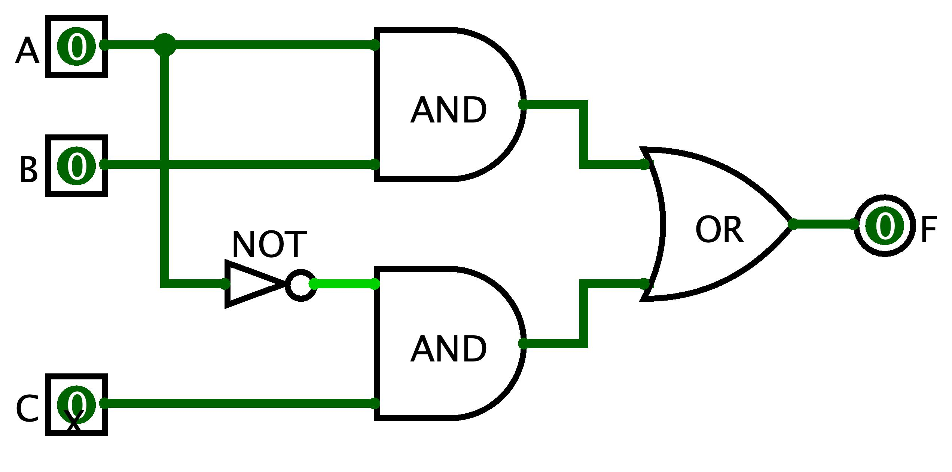
Boolean Functions
Combinations of Boolean inputs resulting in single output
Multiple ways to specify a Boolean function:
Boolean expression: F = (A AND B) OR (NOT(A) AND C)
Circuit diagram with logic gates:
Truth table:
A | B | C | F
0 | 0 | 0 | 0
0 | 0 | 1 | 1
0 | 1 | 0 | 0
0 | 1 | 1 | 1
1 | 0 | 0 | 0
1 | 0 | 1 | 0
1 | 1 | 0 | 1
1 | 1 | 1 | 1

Slide 9
Boolean Expression → Truth Table
We can build a truth table from an expression
Evaluate the Boolean expression on all possible inputs
F(A, B, C) = (A AND B) OR (NOT(A) AND C)
A | B | C | F
0 | 0 | 0
0 | 0 | 1
0 | 1 | 0
0 | 1 | 1
1 | 0 | 0
1 | 0 | 1
1 | 1 | 0
1 | 1 | 1

Slide 10
Boolean Expression → Truth Table
We can build a truth table from an expression
Evaluate the Boolean expression on all possible inputs
F(A, B, C) = (A AND B) OR (NOT(A) AND C)
A | B | C | F
0 | 0 | 0 | 0
0 | 0 | 1 | 1
0 | 1 | 0 | 0
0 | 1 | 1 | 1
1 | 0 | 0 | 0
1 | 0 | 1 | 0
1 | 1 | 0 | 1
1 | 1 | 1 | 1

Slide 11
Boolean Expression ← Truth Table
But can we do it in reverse?
F(A, B, C) = (A AND B) OR (NOT(A) AND C)
?
A | B | C | F
0 | 0 | 0 | 0
0 | 0 | 1 | 1
0 | 1 | 0 | 0
0 | 1 | 1 | 1
1 | 0 | 0 | 0
1 | 0 | 1 | 0
1 | 1 | 0 | 1
1 | 1 | 1 | 1

Slide 12
Boolean Expression ← Truth Table
We can describe a single row with AND and NOT
A | B | C | F
0 | 0 | 0 | 0
0 | 0 | 1 | 1
0 | 1 | 0 | 0
0 | 1 | 1 | 1
1 | 0 | 0 | 0
1 | 0 | 1 | 0
1 | 1 | 0 | 1
1 | 1 | 1 | 1

Slide 13
Boolean Expression ← Truth Table
We can describe a single row with AND and NOT
A | B | C | F
0 | 0 | 0 | 0
0 | 0 | 1 | 1 | NOT(A) AND NOT(B) AND C
0 | 1 | 0 | 0
0 | 1 | 1 | 1
1 | 0 | 0 | 0
1 | 0 | 1 | 0
1 | 1 | 0 | 1
1 | 1 | 1 | 1

Slide 14
Boolean Expression ← Truth Table
We can describe a single row with AND and NOT
A | B | C | F
0 | 0 | 0 | 0
0 | 0 | 1 | 1 | NOT(A) AND NOT(B) AND C
0 | 1 | 0 | 0
0 | 1 | 1 | 1 | NOT(A) AND B AND C
1 | 0 | 0 | 0
1 | 0 | 1 | 0
1 | 1 | 0 | 1
1 | 1 | 1 | 1

Slide 15
Boolean Expression ← Truth Table
We can describe a single row with AND and NOT
A | B | C | F
0 | 0 | 0 | 0
0 | 0 | 1 | 1 | NOT(A) AND NOT(B) AND C
0 | 1 | 0 | 0
0 | 1 | 1 | 1 | NOT(A) AND B AND C
1 | 0 | 0 | 0
1 | 0 | 1 | 0
1 | 1 | 0 | 1 | A AND B AND NOT C
1 | 1 | 1 | 1

Slide 16
Boolean Expression ← Truth Table
We can describe a single row with AND and NOT
A | B | C | F
0 | 0 | 0 | 0
0 | 0 | 1 | 1 | NOT(A) AND NOT(B) AND C
0 | 1 | 0 | 0
0 | 1 | 1 | 1 | NOT(A) AND B AND C
1 | 0 | 0 | 0
1 | 0 | 1 | 0
1 | 1 | 0 | 1 | A AND B AND NOT C
1 | 1 | 1 | 1 | A AND B AND C

Slide 17
Boolean Expression ← Truth Table
Then, we can combine the rows using OR operations
F = NOT(A) AND NOT(B) AND C OR NOT(A) AND B AND C OR
A AND B AND NOT C OR A AND B AND C
A | B | C | F
0 | 0 | 0 | 0
0 | 0 | 1 | 1 | NOT(A) AND NOT(B) AND C
0 | 1 | 0 | 0
0 | 1 | 1 | 1 | NOT(A) AND B AND C
1 | 0 | 0 | 0
1 | 0 | 1 | 0
1 | 1 | 0 | 1 | A AND B AND NOT C
1 | 1 | 1 | 1 | A AND B AND C

Slide 18
Boolean Expression ← Truth Table
But can we do it in reverse?
Yes, we can! The strategy we used is Boolean Function Synthesis
F(A, B, C) = (A AND B) OR (NOT(A) AND C)
✓
A | B | C | F
0 | 0 | 0 | 0
0 | 0 | 1 | 1
0 | 1 | 0 | 0
0 | 1 | 1 | 1
1 | 0 | 0 | 0
1 | 0 | 1 | 0
1 | 1 | 0 | 1
1 | 1 | 1 | 1

Slide 19
Five-minute Break!
Feel free to stand up, stretch, use the restroom, drink some water, review your notes, or ask questions
We’ll be back at:

Slide 20
Which of the following statements is FALSE?
The Boolean Function Synthesis strategy works on every truth table
In CSE 390B, we will be asking you to write Boolean expressions that must be simplified
The abstraction of voltages on a physical wire represents two values
A truth table lists every possible combination of inputs for a Boolean operation
We’re lost…

Slide 21
Lecture Outline
Study Environment Discussion
Boolean Logic and Functions
Boolean Expressions, Circuit Diagrams, Truth Tables
Boolean Function Synthesis Strategy
Hardware Descriptive Languages (HDL)
HDL Syntax, And Gate Example
Implementing an Xor gate in HDL

Slide 22
Hardware Design Language (HDL)
HDL is a programming language to specify hardware components and how they’re connected
Another way of describing a Boolean function!
Many Hardware Design Languages are used today
E.g., VHDL, Verilog, SystemVerilog
In this course, we’ll use a simple HDL language called “HDL”
Unlike Java, HDL is a declarative language. This means the following:
The order of statements (lines of code) doesn’t matter
We are describing a physical system

Slide 23
Hardware Design Language (HDL)
Format of an HDL file
File comment describes expected behavior
IN names chip inputs, OUT names chip outputs
PARTS specify the components (i.e., other gates) that implement the chip
/**
* And gate:
* out = 1 only if both a and b are 1
*/ CHIP And {
IN a, b;
OUT out;
PARTS:
// Put your code here:
}

Slide 24
Reusing Components
You can (and should!) use chips you have already implemented to implement subsequent chips
We give you one gate, Nand, to start out with
Implication: The entire computer you will be building will be use Nand gates as its foundation
We also provide you with some chips you can use without implementing
More details this Thursday when Project 2 is released

Slide 25
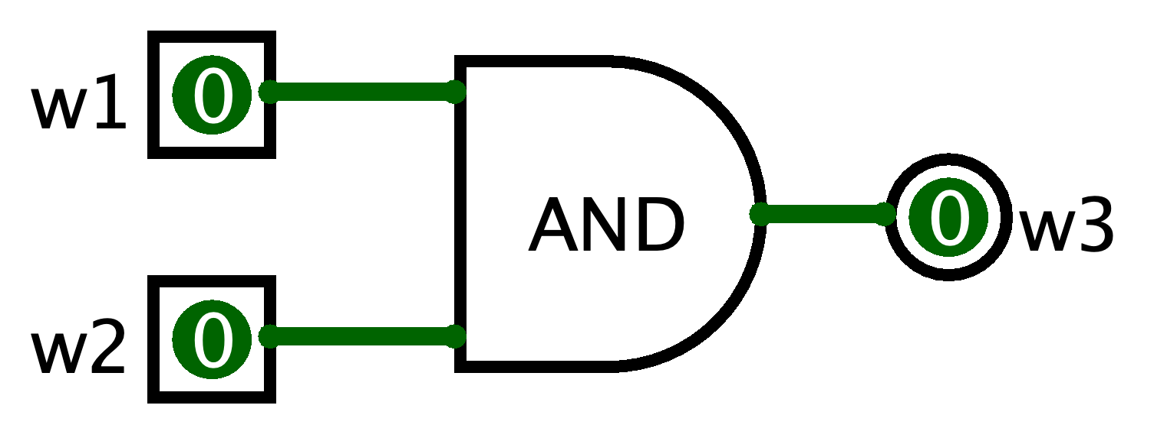
HDL Component Example: AND
The chip specification tells us the name of the input and output wires
Goal: Implement w1 AND w2
HDL Syntax for using (being a client of the And gate): And(a=w1, b=w2, out=w3);
Equivalent circuit diagram:
CHIP And {
IN a, b;
OUT out;
... }

Slide 26
Multi-bit Buses in HDL
It can be useful to manipulate groups of wires
Called a “bus” of wires
HDL provides array like syntax for manipulating buses
And4 chip example:
/**
* Bit-wise And of two 4-bit inputs
*/
CHIP And4 {
IN a[4], b[4];
OUT out[4];
PARTS:
And (a=a[0], b=b[0], out=out[0]);
And (a=a[1], b=b[1], out=out[1]);
And (a=a[2], b=b[2], out=out[2]);
And (a=a[3], b=b[3], out=out[3]);
}

Slide 27
HDL Resources
HDL will feel unfamiliar at first, and that’s okay
Resources for helping you navigate HDL linked under the Resources page on the course website
HDL Survival guide
Appendix A (HDL Spec)
Chip Set Overview (to help you remember the inputs/outputs for various chips)
Chapter readings

Slide 28
Lecture Outline
Study Environment Discussion
Boolean Logic and Functions
Boolean Expressions, Circuit Diagrams, Truth Tables
Boolean Function Synthesis Strategy
Hardware Descriptive Languages (HDL)
HDL Syntax, And Gate Example
Implementing an Xor gate in HDL

Slide 29
The Foundational Building Block
It all starts with the NAND gate
NAND is short for “Not And”
The same output as the AND gate, but every output bit is negated (flipped)
A | B | F
0 | 0 | 0
0 | 1 | 0
1 | 0 | 0
1 | 1 | 1
A | B | F
0 | 0 | 1
0 | 1 | 1
1 | 0 | 1
1 | 1 | 0

Slide 30
Building Gates From Nand
Recall the Boolean Function Synthesis strategy from today’s reading
We saw how we can represent any truth table in terms of three gates: Not, And, Or
First, we can represent Not directly from Nand
Not a = a Nand a
Then, we can represent And in terms of Not and Nand
a And b = Not(a Nand b)
Represent Or in terms of Not and And
Apply De Morgan’s Law
a Or b = Not(Not(a) And Not(b)) [De Morgan’s Law]

Slide 31
Implementing an Xor gate: Overview
Let’s walk through an example of building a gate that you will work on in Project 2, the Xor gate
Together, we’ll implement the Xor gate
/**
* Xor gate:
* out = not(a == b)
*/ CHIP Xor {
IN a, b;
OUT out;
PARTS:
// Put your code here:
}

Slide 32
Implementing an Xor gate: Overview
Plan of action:
Step 1: Create the logic operation’s truth table
Step 2: Use truth table to generate a Boolean function using strategies we’ve learned, such as the Boolean Function Synthesis
Step 3: Convert Boolean function to HDL
/**
* Xor gate:
* out = not(a == b)
*/ CHIP Xor {
IN a, b;
OUT out;
PARTS:
// Put your code here:
}

Slide 33
Implementing an Xor gate: Step 1
Step 1: Create the truth table for Xor
Interpret the specification: F = NOT(A == B)
A | B | F
0 | 0
0 | 1
1 | 0
1 | 1

Slide 34
Implementing an Xor gate: Step 1
Step 1: Create the truth table for Xor
Interpret the specification: F = NOT(A == B)
A | B | F
0 | 0 | 0
0 | 1 | 1
1 | 0 | 1
1 | 1 | 0

Slide 35
Implementing an Xor gate: Step 2
Step 2: Use truth table to generate a Boolean function
Let’s use the Boolean Function Synthesis strategy from the reading
Row 2 = NOT(A) AND B
A | B | F
0 | 0 | 0 | (Row 1)
0 | 1 | 1 | (Row 2)
1 | 0 | 1 | (Row 3)
1 | 1 | 0 | (Row 4)

Slide 36
Implementing an Xor gate: Step 2
Step 2: Use truth table to generate a Boolean function
Let’s use the Boolean Function Synthesis strategy from the reading
Row 2 = NOT(A) AND B
Row 3 = A AND NOT(B)
A | B | F
0 | 0 | 0 | (Row 1)
0 | 1 | 1 | (Row 2)
1 | 0 | 1 | (Row 3)
1 | 1 | 0 | (Row 4)

Slide 37
Implementing an Xor gate: Step 2
Step 2: Use truth table to generate a Boolean function
Let’s use the Boolean Function Synthesis strategy from the reading
Row 2 = NOT(A) AND B
Row 3 = A AND NOT(B)
F = ?
A | B | F
0 | 0 | 0 | (Row 1)
0 | 1 | 1 | (Row 2)
1 | 0 | 1 | (Row 3)
1 | 1 | 0 | (Row 4)

Slide 38
What is the unsimplified Boolean expression result from performing Boolean function synthesis on F = A XOR B?
(A AND NOT(B)) AND (NOT(A) AND B)
(NOT(A) AND B) AND (A AND B)
(A AND B) OR (NOT(A) AND NOT(B))
(NOT(A) AND B) OR (A AND NOT(B))
We’re lost…
A | B | F = A XOR B
0 | 0 | 0 | (Row 1)
0 | 1 | 1 | (Row 2)
1 | 0 | 1 | (Row 3)
1 | 1 | 0 | (Row 4)
Row 2 = NOT(A) AND B
Row 3 = A AND NOT(B)

Slide 39
Implementing an Xor gate: Step 2
Step 2: Use truth table to generate a Boolean function
Let’s use the Boolean function synthesis strategy from the reading
Row 2 = NOT(A) AND B
Row 3 = A AND NOT(B)
F = Row 2 OR Row 3
= (NOT(A) AND B) OR (A AND NOT(B))
A | B | F
0 | 0 | 0 | (Row 1)
0 | 1 | 1 | (Row 2)
1 | 0 | 1 | (Row 3)
1 | 1 | 0 | (Row 4)

Slide 40
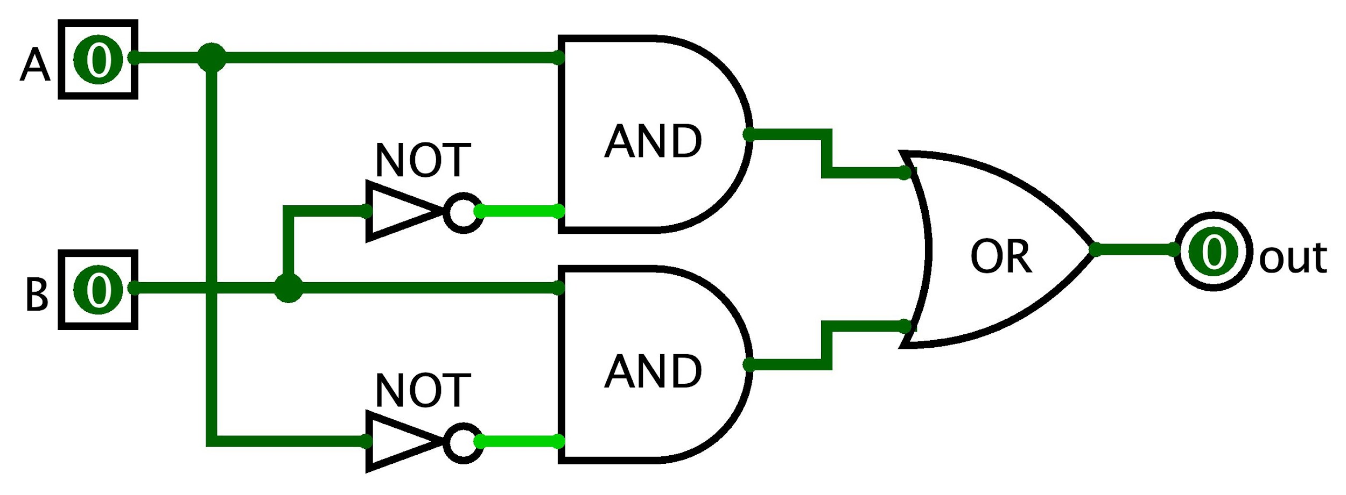
Implementing an Xor gate: Step 3
Now that we have a Boolean expression, we can implement the Xor gate in HDL
Optionally, it can help to express the Boolean expression as a circuit diagram
A XOR B = (NOT(A) AND B) OR (A AND NOT(B))

Slide 41
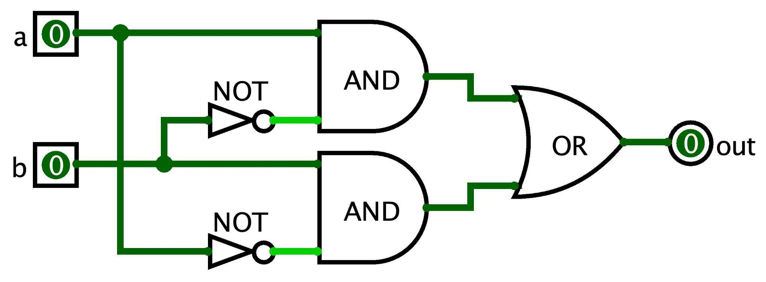
Implementing an Xor gate: Step 3
Step 3: Convert Boolean function to HDL syntax
A XOR B = (NOT(A) AND B) OR (A AND NOT(B))
Assumes Not, And, and Or are already implemented
Note the use of intermediary wires: nota, notb, x, and y
CHIP Xor {
IN a, b;
OUT out;
PARTS:
Not (in=a, out=nota);
Not (in=b, out=notb);
And (a=a, b=notb, out=x);
And (a=nota, b=b, out=y);
Or (a=x, b=y, out=out);
}

Slide 42
Wrapping Up
Exciting lecture topics this Thursday!
Metacognitive Subject: Time Management
Technical Subject: Making Decisions in Hardware, Project 2 Overview
Project 1 due this Thursday (10/6) at 11:59pm
Preston has office hours after class in CSE2 153
First Student-TA meetings starting this week
Your TA will be in contact with you about the first meeting (if not already)

